Slide 1


Amazon Sales Analysis

Slide 2
Problem Statement
Sales management has gained importance to meet increasing competition and the need for improved methods of distribution to reduce cost and to increase profits. Sales management today is the most important function in a commercial and business enterprise.

Slide 3
Objective
* Perform ETL(Extract- Transform – Load) on Amazon Dataset and analyze sales trend (Month wise, Year wise, Yearly Month wise).
* Find key metrics and factors and show meaningful relationship between attributes.

Slide 4
About Dataset
Region
Country
Item type
Sales channel
Order priority
Order Date
Order Id
Ship Date
Units sold
Unit Price
Unit Price
Total Revenue
Total cost
Total profit

Slide 5
Key insights
Total Revenue: 137.35 M
Units Sold: 512871
Total Profit: 44.17 M
Average Unit Price:
276.7613
Average Unit Cost: 191.048

Slide 6
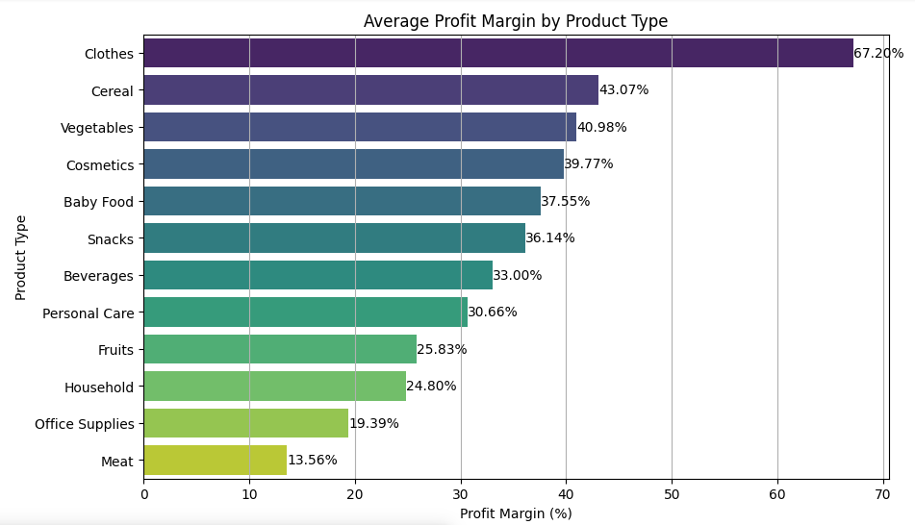
Which product have the highest profit margin

Slide 7
Which product have the highest profit margin
Clothes have the highest profit margin at 57.47%.
Cereal and Vegetables follow with profit margins of 50.82% and 49.78%, respectively.
Cosmetics and Baby Food also have relatively high profit margins at 39.87% and 38.89%.
Office Supplies and Meat have the lowest profit margins at 19.35% and 33.35%, respectively.

Slide 8
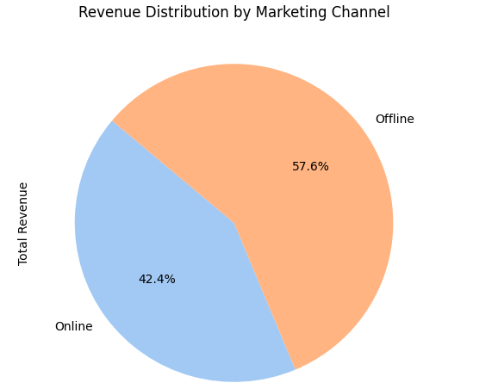
Which marketing channels drive the most

Slide 9
Which marketing channels drive the most
Offline Channels: Contribute a larger share of total revenue, accounting for 57.6%.
Online Channels: Make up the remaining 42.4% of the total revenue.

Slide 10
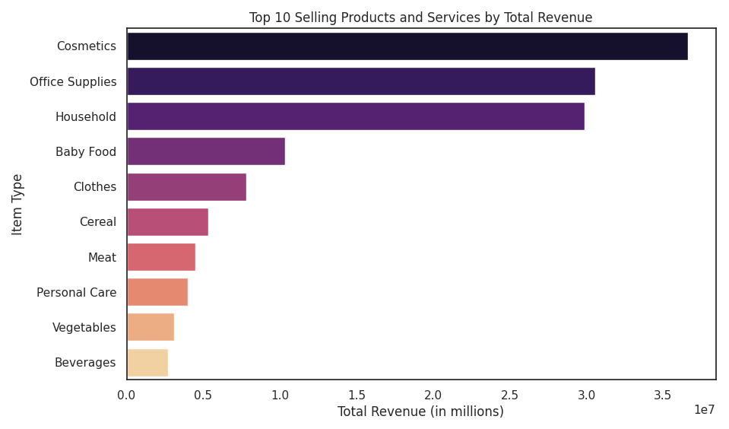
Top Selling Products

Slide 11
Top Selling Products
Cosmetics generate the highest revenue, close to $3.5 million.
Office Supplies and Household items also have high revenues.
Beverages have the lowest revenue among the top 10, slightly above $0.5 million.

Slide 12
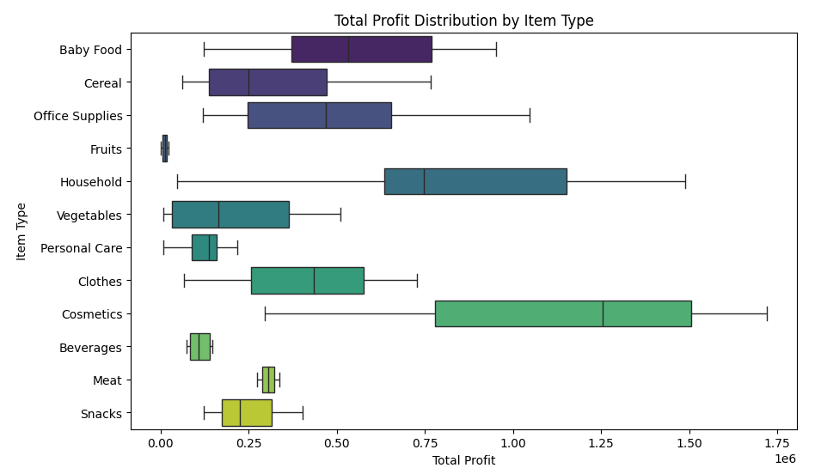
Total Profit Distribution by Item type

Slide 13
Total Profit Distribution by Item type
Consistent Profits: Categories like Baby Food, Fruits, Personal Care, and Cosmetics have narrow distributions, indicating stable profits.
Variable Profits: Office Supplies and Clothes show wider distributions with outliers, suggesting variability in profits.
Inconsistent Profits: Beverages, Snacks, and Meat have small boxes with multiple outliers, indicating inconsistent profit

Slide 14
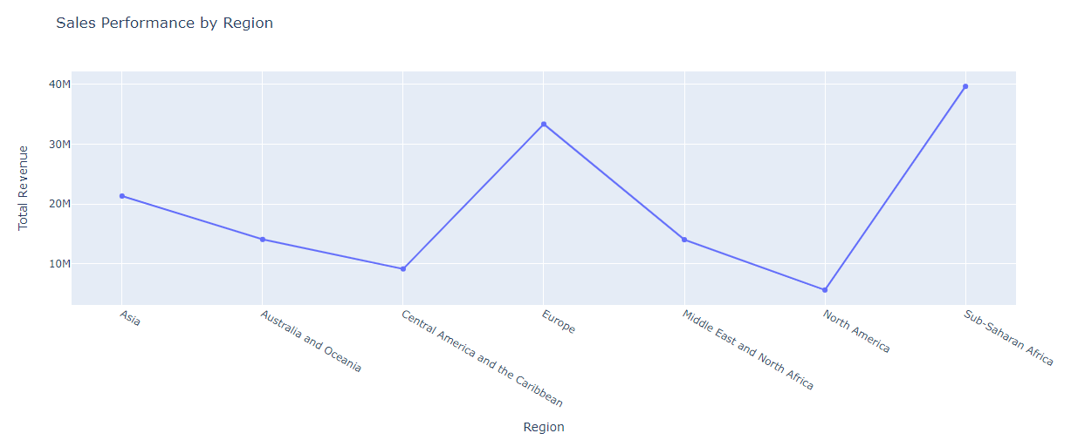
How Does Sales Performance Vary By Region

Slide 15
How Does Sales Performance Vary By Region
East Region: This region has the highest peak in sales performance.
South Region: This region shows a significant trough, indicating lower sales performance.
Central, North, and Westcoast Regions: These regions have moderate sales performance with some fluctuations.

Slide 16
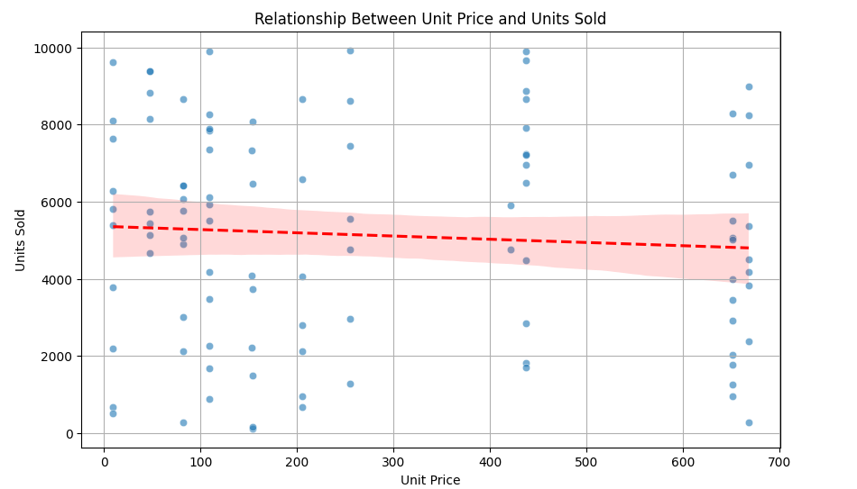
How Does Pricing Affect Sales Volume

Slide 17
How Does Pricing Affect Sales Volume
Inverse Relationship: The chart shows that as the unit price increases, the number of units sold decreases.
Trend Line: A red trend line indicates this inverse relationship, with a shaded pink area representing the confidence interval.
Data Points: Numerous blue dots represent the correlation between specific unit prices and the number of units sold.

Slide 18
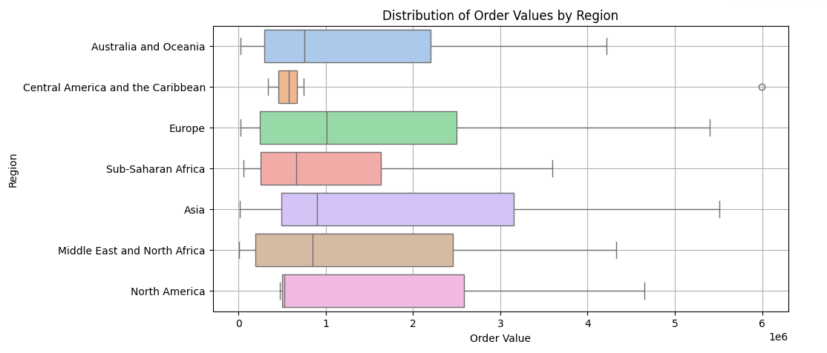
Distribution OF Order Values

Slide 19
Distribution OF Order Values
North America has the highest order value, reaching up to 6.
Australia and Oceania and Europe have moderate order values, around 3.
Central America and the Caribbean, Sub-Saharan Africa, Asia, and Middle East and North Africa have lower order values, below 3.

Slide 20
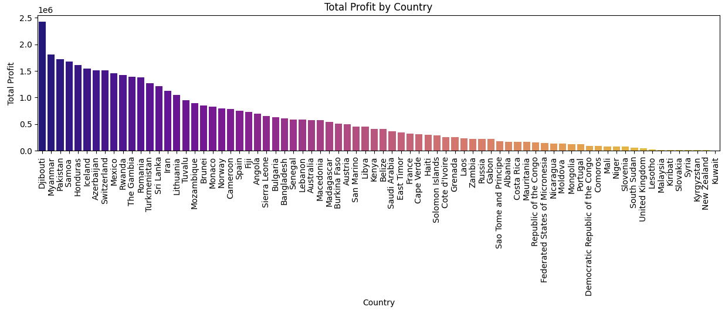
Total Profit By Country

Slide 21
Total Profit By Country
Highest Profit:
The country with the highest total profit (close to 2.5 million dollars) is Djibouti.
Lowest Profit:
The country with the lowest total profit is on the far right of the chart, and it is Democratic Republic of the Congo.

Slide 22
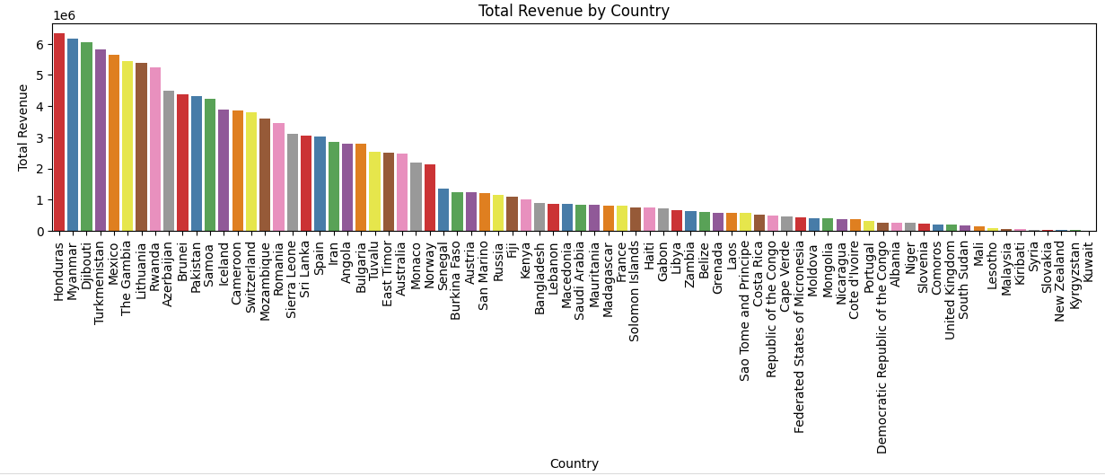
Total Revenue By Country

Slide 23
Total Revenue By Country
Highest Revenue:
The country with the highest total revenue is Honduras, with a revenue close to 6 billion dollars.
Lowest Revenue:
The country with the lowest total revenue is Kuwait ,with a significantly lower revenue compared to Honduras.

Slide 24
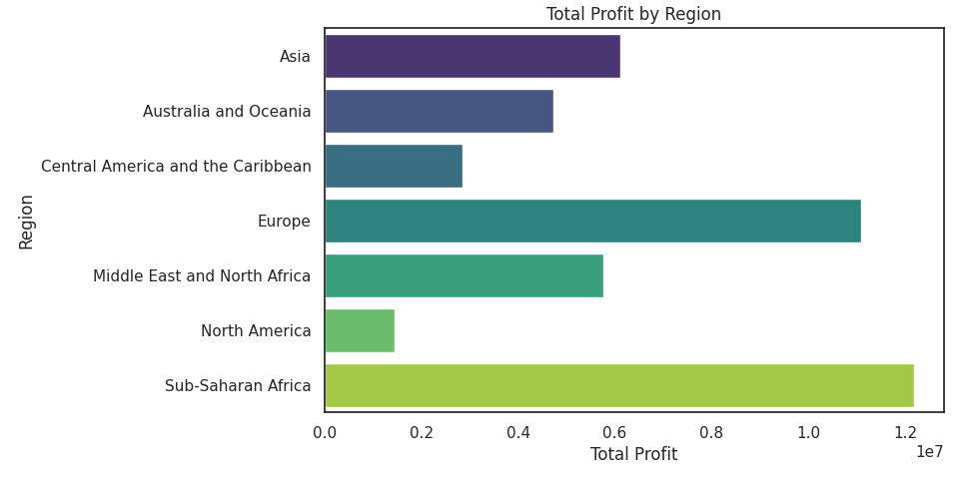
Total Profit By Region

Slide 25
Total Profit By Region
North America has the highest total profit, exceeding 1.0 on the profit scale.
Asia Oceania follows North America with the second highest total profit.
Middle East and North Africa and Australia and New Zealand have moderate profit values, with Australia and New Zealand slightly lower.
Sub-Saharan Africa has the lowest total profit among the listed regions.

Slide 26
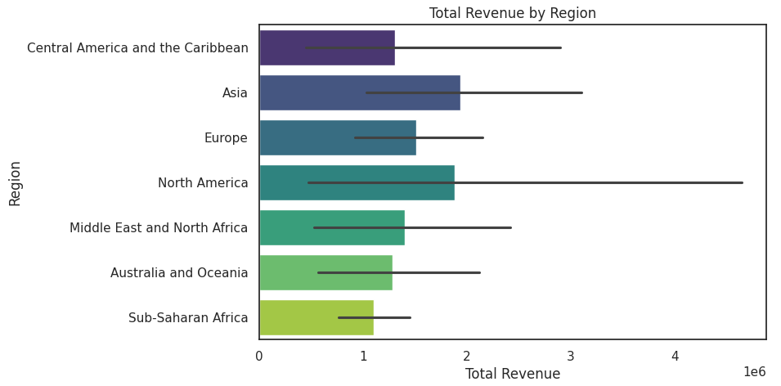
Total Revenue By Region

Slide 27
Total Revenue By Region
Asia has the highest total revenue, reaching close to 4 units on the revenue scale.
Europe follows Asia with the second highest total revenue.
North America, Central America and the Caribbean, Middle East and North Africa, and Australia and Oceania have moderate revenue values.
Sub-Saharan Africa has the lowest total revenue among the listed regions.

Slide 28
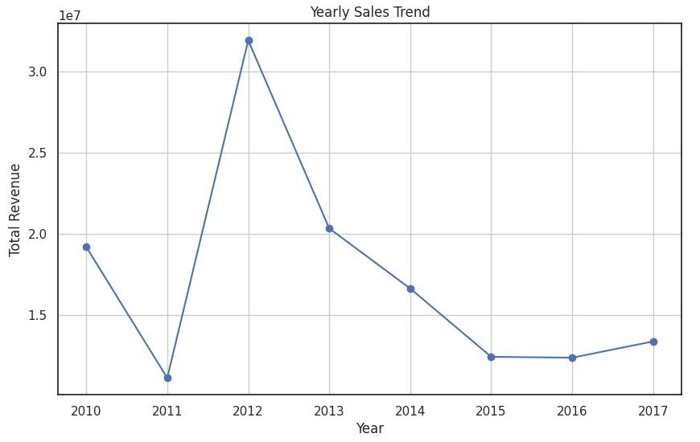
Yearly Sales Trend

Slide 29
Yearly Sales Trend
Peak Revenue (2012):
The peak revenue in 2012 is approximately 25 million.
Stabilized Revenue (2014-2017):
The revenue stabilizes around or slightly below 10 million.

Slide 30
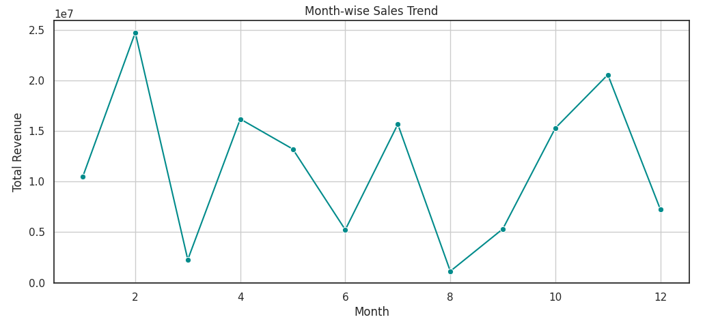
Month Wise Sales Trend

Slide 31
Month Wise Sales Trend
Highest Peak (March):
The highest revenue peak occurs in March, reaching just above 20 million.
Other Peaks (June and November):
There are additional peaks in June and November, with revenues around 18 million and 15 million, respectively.
Lowest Revenue (September):
The lowest revenue is in September, dropping close to zero.

Slide 32
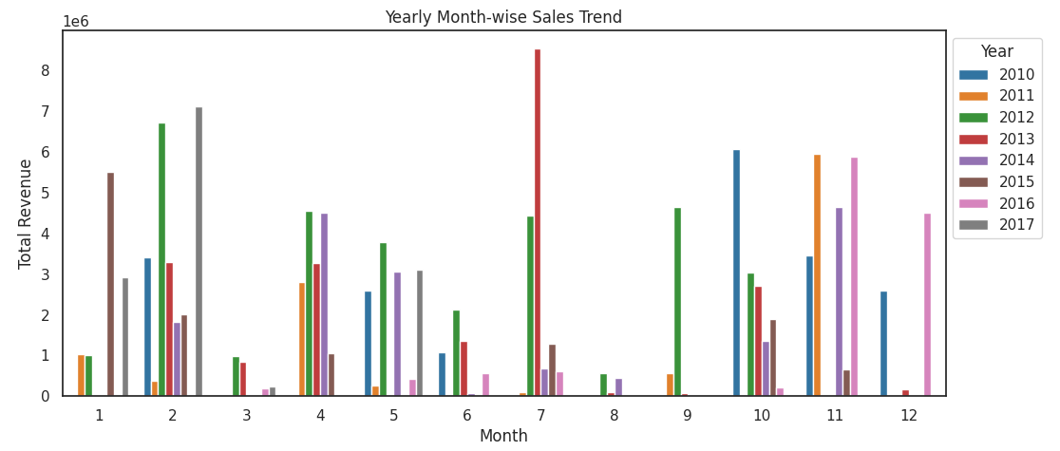
Yearly Month Wise Sales Trend

Slide 33
Yearly Month Wise Sales Trend
Highest Revenue Months: March and December, up to 8 million.
Seasonal Trends: Noticeable sales peaks in specific months.
Yearly Variations: Some months have consistent high revenue; others vary significantly.
Lowest Revenue Months: September, below 2 million.

Slide 34
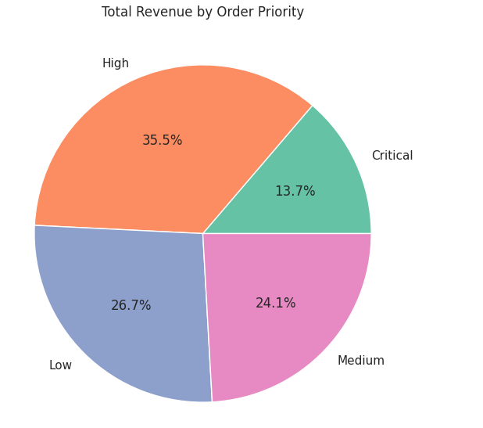
Total revenue by order priority

Slide 35
Total revenue by order priority
High Priority:
The largest segment, accounting for 35.5% of the total revenue.
Low Priority:
The second largest segment, making up 26.7% of the total revenue.
Medium Priority:
Accounts for 24.1% of the total revenue.
Critical Priority:
The smallest segment, contributing 13.7% of the total revenue.

Slide 36
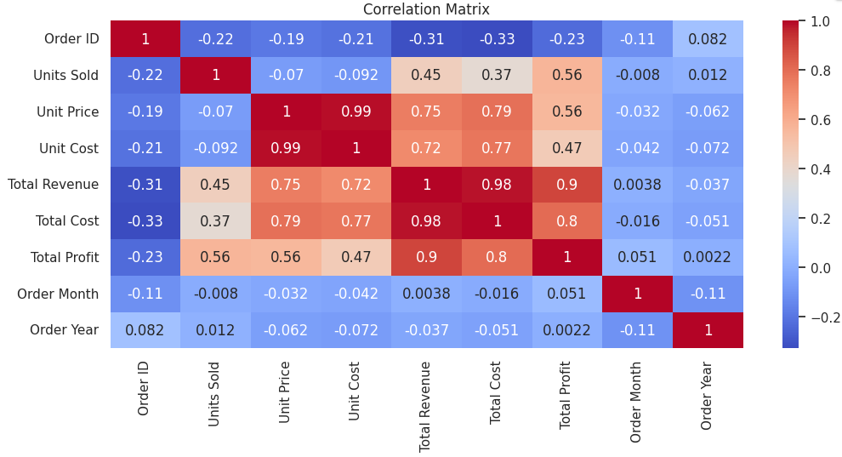
Corelation metrics

Slide 37
Corelation metrics
Strong Positive Correlations:
Total Revenue and Total Cost: High positive correlation (0.99).
Total Revenue and Units Sold: Strong positive correlation (0.95).
Total Profit and Units Sold: Positive correlation (0.72).
Negative Correlation:
Order Month and Unit Price: Negative correlation (-0.21).
Perfect Correlations:
Each metric with itself: Perfect positive correlation (1.0).

Slide 38
Conclusion
Clothes, Cereal, and Vegetables have the highest profit margins.
Office Supplies and Meat have the lowest profit margins.
High Priority orders contribute the most to total revenue.
Djibouti has the highest total profit; Honduras has the highest total revenue.
North America and Asia are the top regions for profit and revenue.

Slide 39
Conclusion
Offline channels generate more revenue than online.
An inverse relationship exists between unit price and units sold.
March, June, and November are peak revenue months; September is the lowest.

Slide 40


